Slide 1

IDSA Ecosystem Building Call ‧ Component Development Session
—
Eclipse Dataspace Connector
Julia Pampus ‧ Fraunhofer ISST

Slide 2
Pillars of a Data Space
Data spaces allow organizations to securely share data with other participants
Data spaces enable data cooperation in a multi-cloud federation
Data spaces are built on
Identity: Each participant remains in control of their identity
Trust: Each participant decides who to trust
Sovereignty: Each participant decides under what policies their data is shared
Interoperability: Each participant remains in control of their deployment
Discover
Publish
Share
Maintain Control

Slide 3
New Data Sharing Challenges
Connection and interoperability with multiple data spaces
Identity across multiple jurisdictions
Handle diverse data (transfer) types (e.g., streaming, big data)
Cataloging across many data providers
Policy management on multiple infrastructure layers
Accommodate diverse requirements and use cases
C
C
C
C
H
C
H
C
C
C
C
C
I
I
C
C

Slide 4

Eclipse Dataspace Connector

Slide 5

Quick Facts
Eclipse
Dataspace
Connector
1
Open Source
started in June 2021 ‧ official Eclipse Foundation project ‧ Apache 2.0 License
2
Community
12 committers ‧ 20+ contributors ‧ >600 pull requests
3
Technology
based on Java ‧ extensible architecture
4
Enterprise-ready
scalable ‧ higly available ‧ customizable
5
Current State
runnable code ‧ basic end to end samples

Slide 6







Contributors, Committers & Partners

Slide 7
Design Principles
Separation of information flows (control) and data transfer (exchange)
Asynchro-nous and highly available
Modular and extensible
System security (using e.g. vaults and encryption)
Cloud-aware policy enforcement
Fully auditable processes

Slide 8






Technical Capabilities
Identity Provider
Monitoring
Configuration
Connector
Identity Management*
Connector
Cataloging*
Contract Management
Offer
Policy
Engine
(Policy)
Catalog
Data
Source/Sink
Data Transfer
Data
Source/Sink
Data
Data
Source/Sink
*either centralized or decentralized

Slide 9
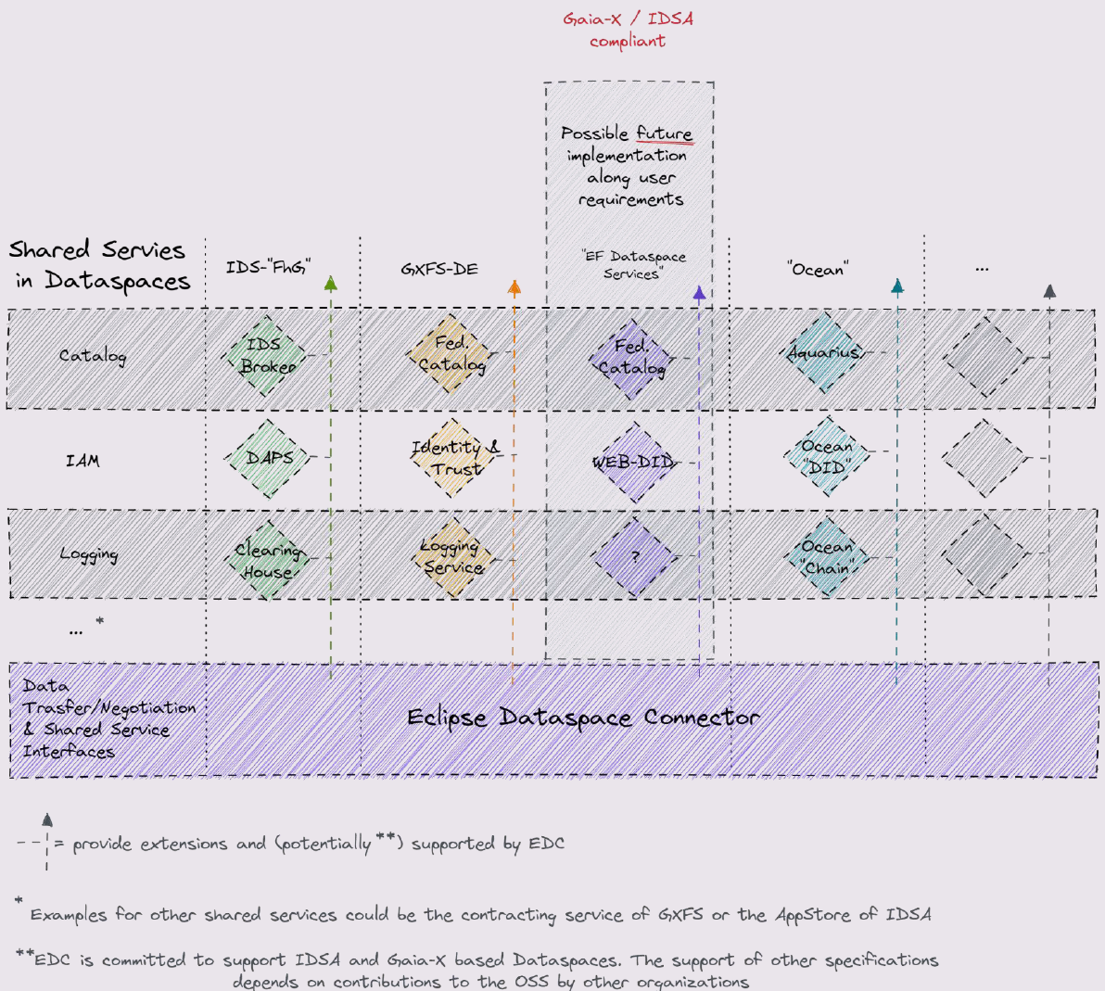
Eco-system Integration

Slide 10

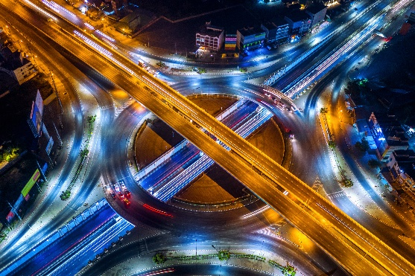
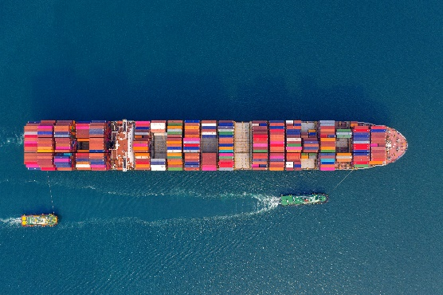


Alignment with Gaia-X
Fulfilment of mandatory and further criteria
Support for Gaia-X Trust Framework
Support Gaia-X compliant Self-Description
Gaia-X Registry Extension and support for Verifiable Credentials (VC)
Possible alignment with Gaia-X Federation Services v2
Possible integration with GXFS-DE implementation projects
Alignment with lighthouse projects (e.g., Catena-X)

Slide 11


Alignment with IDSA
1
Support of IDS communication protocols, ontology & central services
2
Support development of IDS Reference Architecture Model (RAM) 4.0
3
Part of IDSA Open Source Landscape (IDSA Graduation Scheme)
4
Participating in IDSA committees and working groups
5
Maintenance of IDS Infomodel Serializer and CodeGen tools

Slide 12
Important Links
Eclipse Foundation
Eclipse project page: https://projects.eclipse.org/projects/technology.dataspaceconnector
EDC project proposal: https://projects.eclipse.org/proposals/eclipse-dataspace-connector
Community mailing list: https://accounts.eclipse.org/mailing-list/dataspaceconnector-community
Developer mailing list: https://accounts.eclipse.org/mailing-list/dataspaceconnector-dev
GitHub
Main Repository: https://github.com/eclipse-dataspaceconnector/DataSpaceConnector
Documents & presentations: https://github.com/eclipse-dataspaceconnector/Collateral
Publications: https://github.com/eclipse-dataspaceconnector/Publications
Documentation: https://eclipse-dataspaceconnector.github.io/DataSpaceConnector/
Bi-weekly Q&A session: https://github.com/eclipse-dataspaceconnector/DataSpaceConnector/discussions/1303
YouTube Channel: https://www.youtube.com/channel/UCYmjEHtMSzycheBB4AeITHg

Slide 13
Contact
—
Julia Pampus, M.Sc.
Research Associate, Data Business
Tel. +49 231 97677 - 429
julia.pampus@isst.fraunhofer.de
https://www.isst.fraunhofer.de/en.html

Slide 14
Thank You.

